Slide 1

Project P375
REGRESSION

Slide 2
Group members
Arati Shankar Padwal
Jayathwala Chandana
Abishek Dwivedi
Hanifa Aga
Odnala sashma
Thumma Akhila
Dipali Rajaram Nevase
Potlapally Mithun Kumar

Slide 3
objective
The Main Aim of project is to need perform regression to summarize the insurance cost

Slide 4



Project flow
Data collection
Exploratory Data Analysis(EDA)
Data Visualization
Model Construction and Evaluation
Deployment

Slide 5
Data Collection

Slide 6
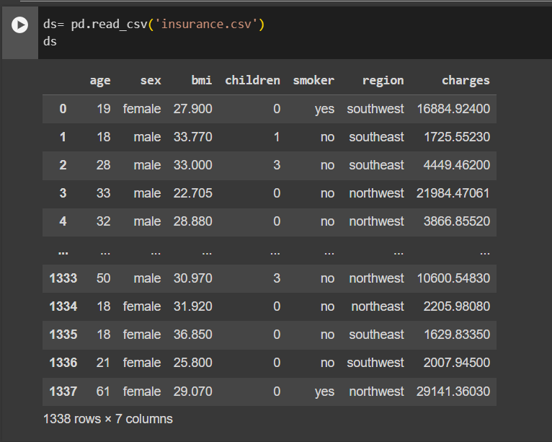
Load data in Google colab by creating variable as ds.

Slide 7
Exploratory Data Analysis
{EDA}

Slide 8
EDA
In EDA is a step to ensure the data is cleaned and ready for processing, providing insights and preventing errors

Slide 9
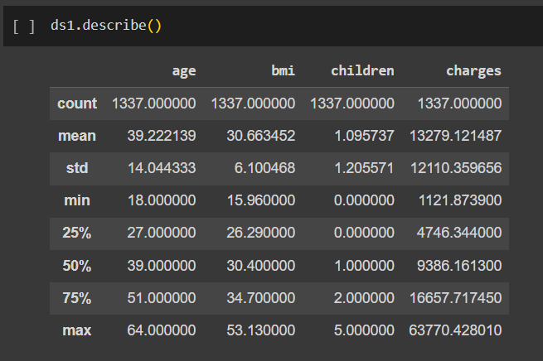
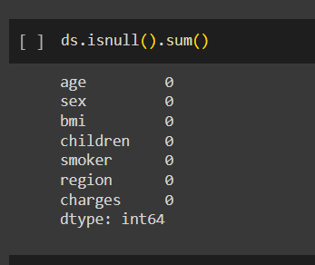
Describing the data
Data set details:
No. of rows: 1338
No.fo columns: 7
What we have done with data:
Missing values
Finding duplicates values
Finding outlier

Slide 10
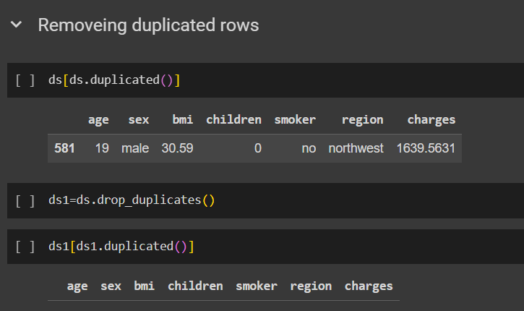
Removing duplicate rows
Duplicate data can have detrimental effects on your machine learning models and outcomes, such as reducing data diversity and representativeness, which can lead to overfitting or biased models.

Slide 11
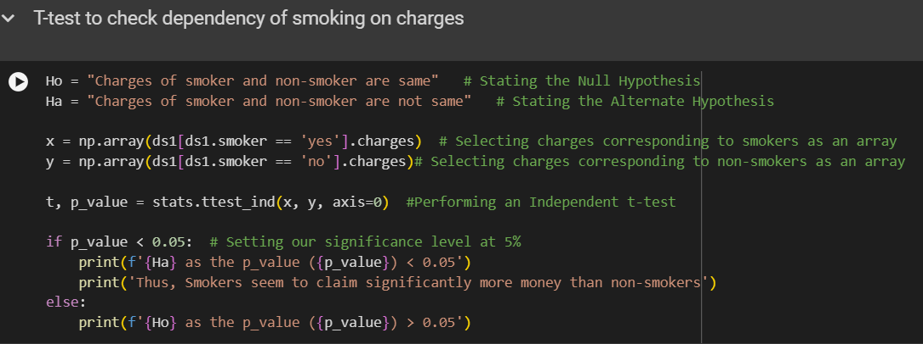
Understanding the data
A t-test is an inferential statistic used to determine if there is a significant difference between the means of two groups and how they are related
Charges of smoker and non-smoker are not same as the p_values (1.4067220949376498e-282) < 0.05 . Thus, smokers seem to claim significantly more money than non-smokers

Slide 12
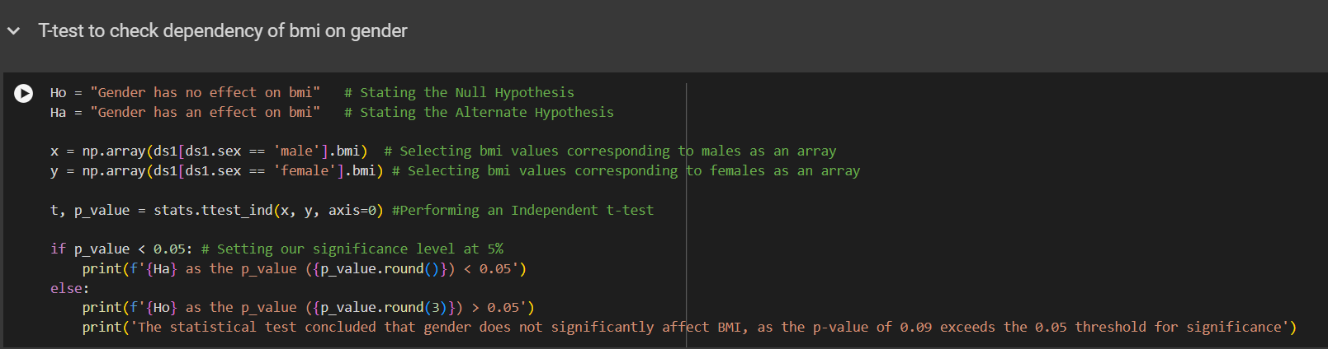
Gender has no effect on bmi as the p_value (0.09) > 0.05 .
The statistical test concluded that gender does not significantly affect BMI, as the p-value of 0.09 exceeds the 0.05 threshold for significance

Slide 13
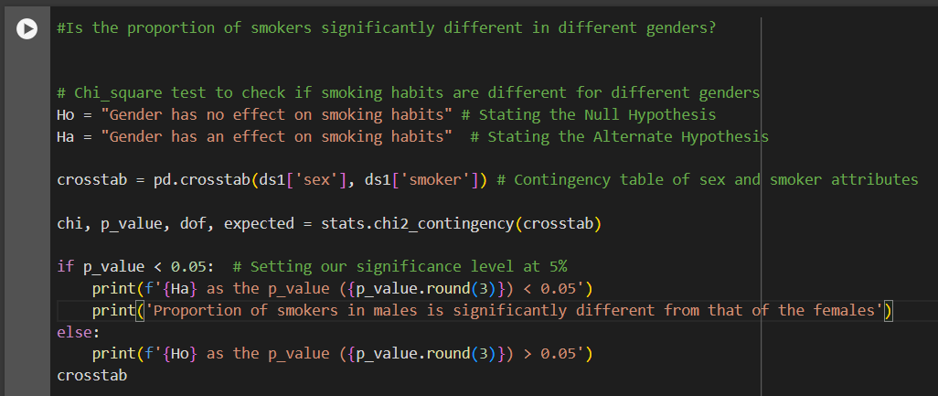
Chi square test for dependency of smokers on gender
The chi-square test is a statistical tool used to check if two categorical variables are related or independent.
Gender has an effect on smoking habits as the p_value (0.006) < 0.05 Proportion of smokers in males is significantly different from that of the females

Slide 14
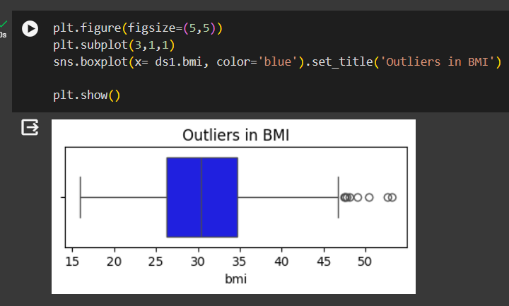
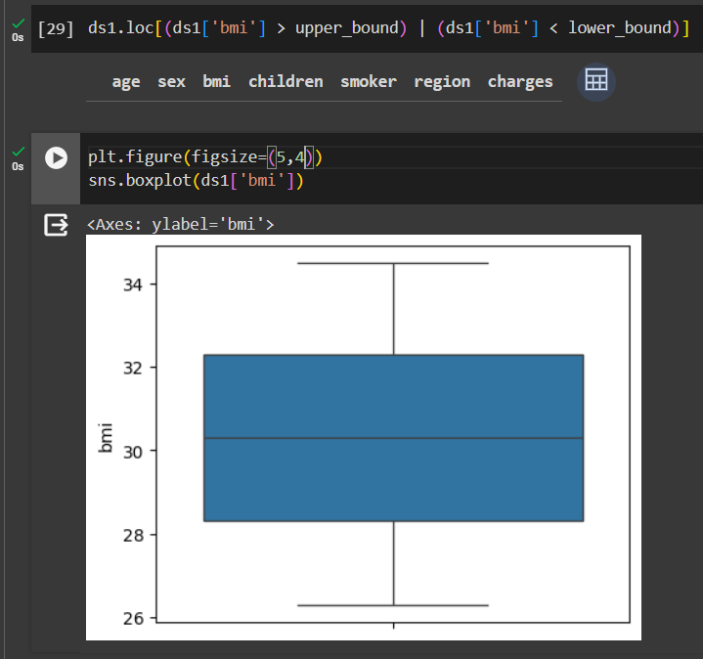
Removing outliers
One of the most important steps as part of data preprocessing is detecting and treating the outliers as they can negatively affect the statistical analysis and the training process of a machine learning algorithm resulting in lower accuracy. So we have to remove outliers from the dataset

Slide 15

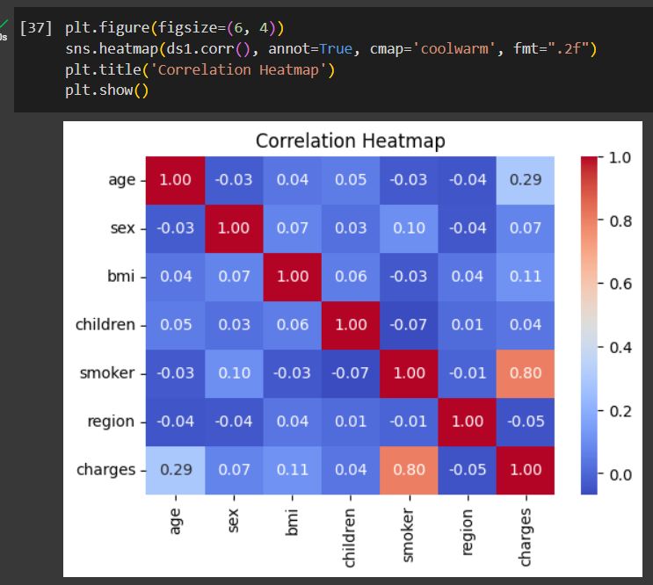
Correlation
Correlation is a statistical measure that expresses the extent to which two variables are linearly related(they change together at a constant rate). It’s common tool for describing simple relationships without making a statement about cause and effect.

Slide 16
Model Building
and Evaluation

Slide 17
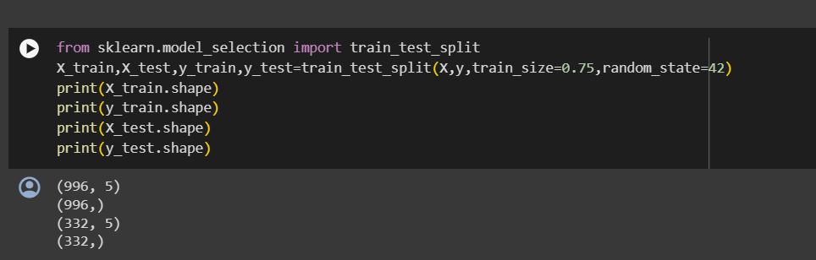
Split data into train and test data
Data splitting allows for creating a testing set, providing real-world checks for checking how well a model performs on new data. Without a dedicated testing set, the risk of overfitting increases when model adapts too closely to the training data.

Slide 18
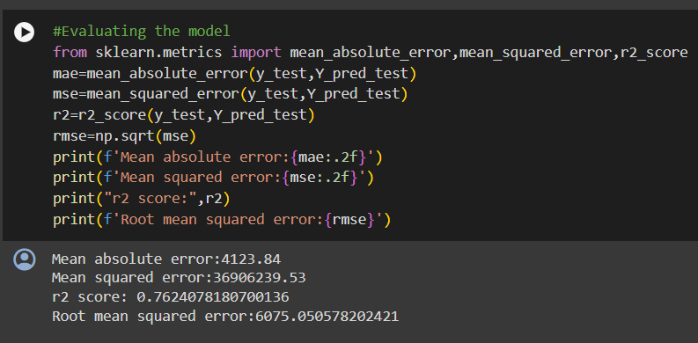
Linear regression model
Linear regression is a supervised machine learning method that is used by the Train Using AutoML tool and finds a linear equation that best describes the correlation of the explanatory variables with the dependent variable. This is achieved by fitting a line to the data using least squares.

Slide 19
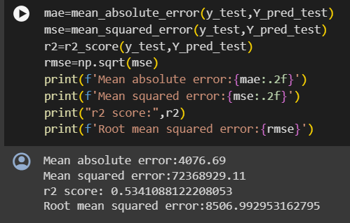
Support vector regression - SVR
Support Vector Regression is a supervised learning algorithm that is used to predict discrete values. Support Vector Regression uses the same principle as the SVMs. The basic idea behind SVR is to find the best fit line. In SVR, the best fit line is the hyperplane that has the maximum number of points.

Slide 20
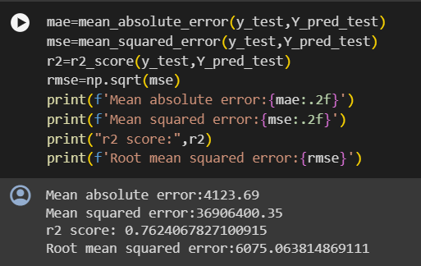
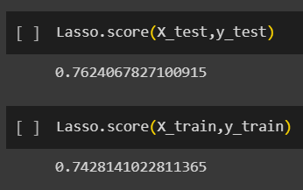
Lasso regression
Lasso regression can be used to identify the most important features in a dataset by shrinking the coefficient of less important features to zero, thus helping to reduce the risk of overfitting.
It can help improve the accuracy of the model by selecting the most relevant features from a large number of features.

Slide 21
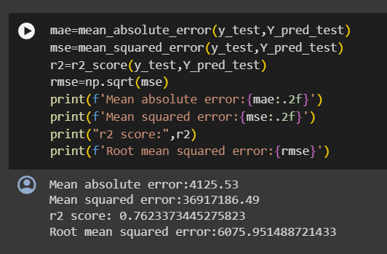
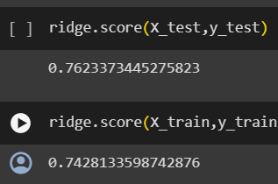
Ridge Regression
Ridge regression is a model-tuning method that is used to analyze any data that suffers from multicollinearity. This method performs L2 regularization. When the issue of multicollinearity occurs, least-squares are unbiased, and variances are large, this results in predicted values being far away from the actual values.

Slide 22
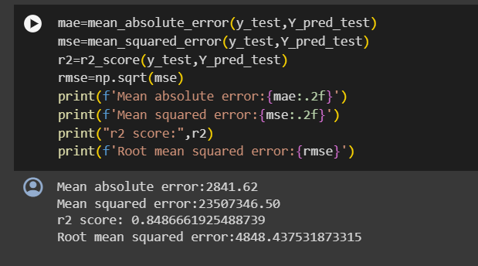
Decision Tree Regression
Decision tree regression observes features of an object and trains a model in the structure of a tree to predict data in the future to produce meaningful continuous output. Continuous output means that the output/result is not discrete, i.e., it is not represented just by a discrete, known set of numbers or values.

Slide 23
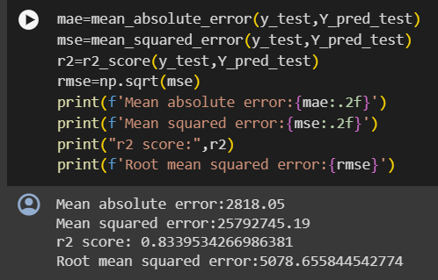
Bagging Regression
A Bagging regressor is an ensemble meta-estimator that fits base regressors each on random subsets of the original dataset and then aggregate their individual predictions (either by voting or by averaging) to form a final prediction.

Slide 24
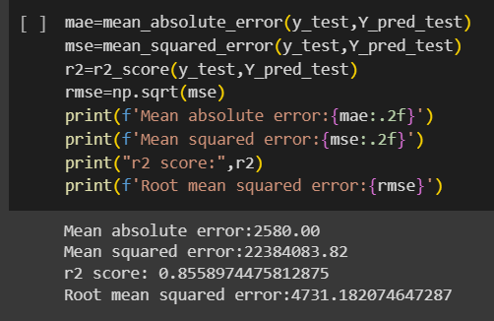
Random Forest Regression
Random Forest Regression in machine learning is an ensemble technique capable of performing both regression and classification tasks with the use of multiple decision trees and a technique called Bootstrap and Aggregation, commonly known as bagging.
Random forest regression model is giving best accuracy score. We are going to use Random forest regression model for model building.

Slide 25
Model Deployment
Deployment in Machine Learning is the method by which you integrate a machine learning model into an existing production environment to make decisions based on data. It is the last stage in the machine learning lifecycle.
We first build seven models. Among them, a Random forest regression model is used and deployed using Streamlit.

Slide 26
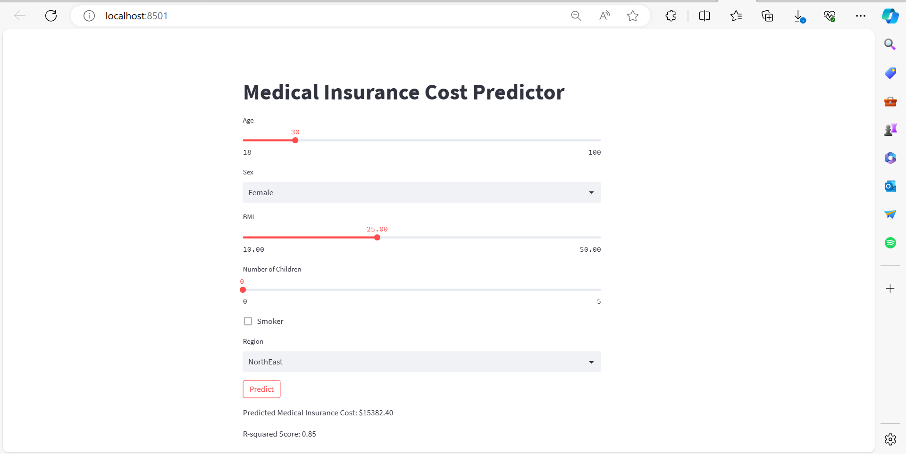

Slide 27

Thank You!

